Slide 1
Home rental system Project Phase II TA. <Kholoud Khaled>
# | Names | IDs | Group | Email
1 | Mario samy Sabry | 20198067 | B2 | Samymario636@gmail.com
2 | Beshoy Hanna Ayad | 20198019 | B2 | beshoyhanna2000@gmail.com
3 | Fatma Mohammed Abdelgafour | 20198064 | B2 | fatmaokasha01@gmail.com
4 | Hadeel Ali Saleem | 20198097 | B2 | hadeelataya63@gmail.com

Slide 2
Purpose:
Home is the perfect place for accommodating family, also people look for many factors before they settle on a specific place so this process is not easy. The main purpose of our application is to make the process much easier for users by which:
Listing the property based on the requirement of the user
No broker or middleman can gain commission Unlike the traditional methods
Filtering on websites so that users factor out the unnecessary properties such as pricey properties
Providing a variety of ways for your tenants to pay instead of waiting for the check or asking tenants for the rent.

Slide 3
Scope
Our project covers a lot of features as follows:
Automatic Payment of House Rent Online
Requesting for the Home Maintenance through App
Providing Additional Information about the Locality
Offering the Rewards and Attractive Offers
Providing a Comprehensive Marketplace

Slide 4
Audience
This application is available for all people any one can rent a house with different budgets.
System Overview:
Investing by renting a property is not suitable for all investors, because problems are bound to occur sooner or later, even if the properties are completely new.

Slide 5
Assumptions and/or constraints
Availability:
The system should be available at the working time.
Security:
Some information must be secure
Daily Load:
The average number of the invocation per day from 700-900 invocation
Peak load:
The maximum number of invocation per day must didn’t exceed 1000
Size Per Submission:
The maximum number in mb of the uploaded data
Expected Lifespan:
The expected time that data can be available at the system

Slide 6
System Requirements: 1-Functional Requirements:
For the landlords:
1-He adds the name of the property, its location, photos, description and its size
2- Set a period of time for a period of no less than two months for the tenant to vacate the property to give him an opportunity to search for another place to live.
3- If the tenant remains in the property after the two-month period, you can resort to the judiciary to issue a possession order.
For the administrator:
1-He accepts the property that the property owner adds or refuse it.
2- The home rental system has a service to follow up on price changes monthly

Slide 7
For the tenant:
He can search about property near him or in any location he wants or in specific dates.
Some rules and safety requirements that the tenant must abide by must be agreed upon to avoid major problems and damages that the tenant may cause intentionally or unintentionally.
He can cancel a renting if within the cancellation period.
2-Non-Functional Requirements:
Availability:
Working hours and holidays:
The system shall be available in normal working hours which are from 8:00 AM to 10:00 PM.
The system is not available on Friday.

Slide 8
Security:
Log in and password:
The user has only 3 tries to log in, then he/she has to wait for 2 minutes for the next try.
If the user forgot his password, the system would send him an email for authentication to his phone number or his email that he used to create an account.
Transaction and exchanging money:
The user must input the OTP that was send to his phone number after only 30 seconds from sending the message or he/she will need another OTP from his bank account for exchanging money.
Peak load:
The maximum number of invocation per day must didn’t exceed 1000
The system if exceed the peak load should be view a message that the system will be restart before restarting the system to alert the customers that there process didn’t done.

Slide 9
Size Per Submission:
The maximum number in mb of the uploaded data Such as:
The maximum size of uploading the home images is 50 MB.
The maximum size of uploading profile picture is 10MB.
Expected Lifespan:
The expected time that data can be available at the system
Are 120 days, then the data will be deleted and send message to its owner to alert him.
Transaction and exchanging money:
Transaction process shall take only 3 seconds to exchange money from user’s bank account to the landlord.
Accepted currencies are the country’s official currency and dollar as another option.
Laws and legal process:
The system shall review the rent laws in each country every 6 months and update any changes if there is any.

Slide 10
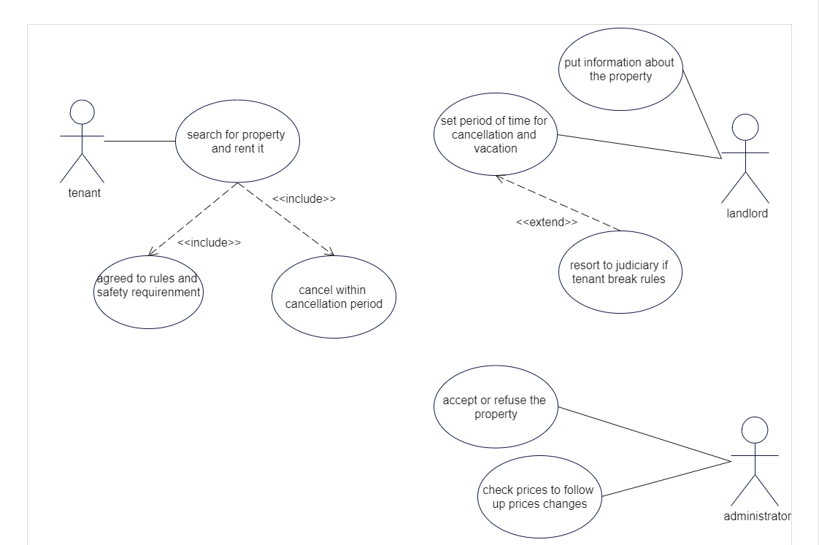
Use Case Diagram

Slide 11
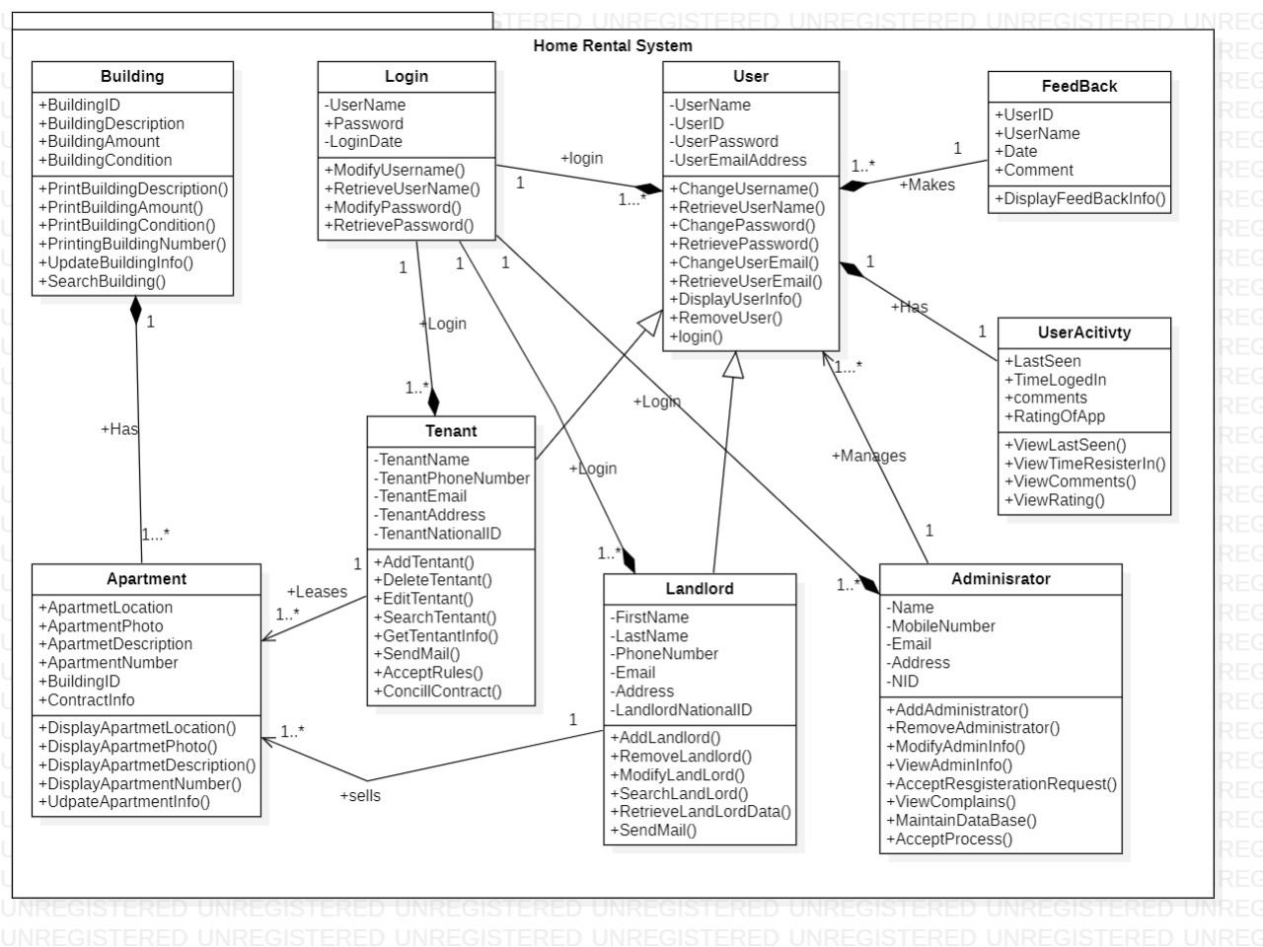
Class diagram:

Slide 12
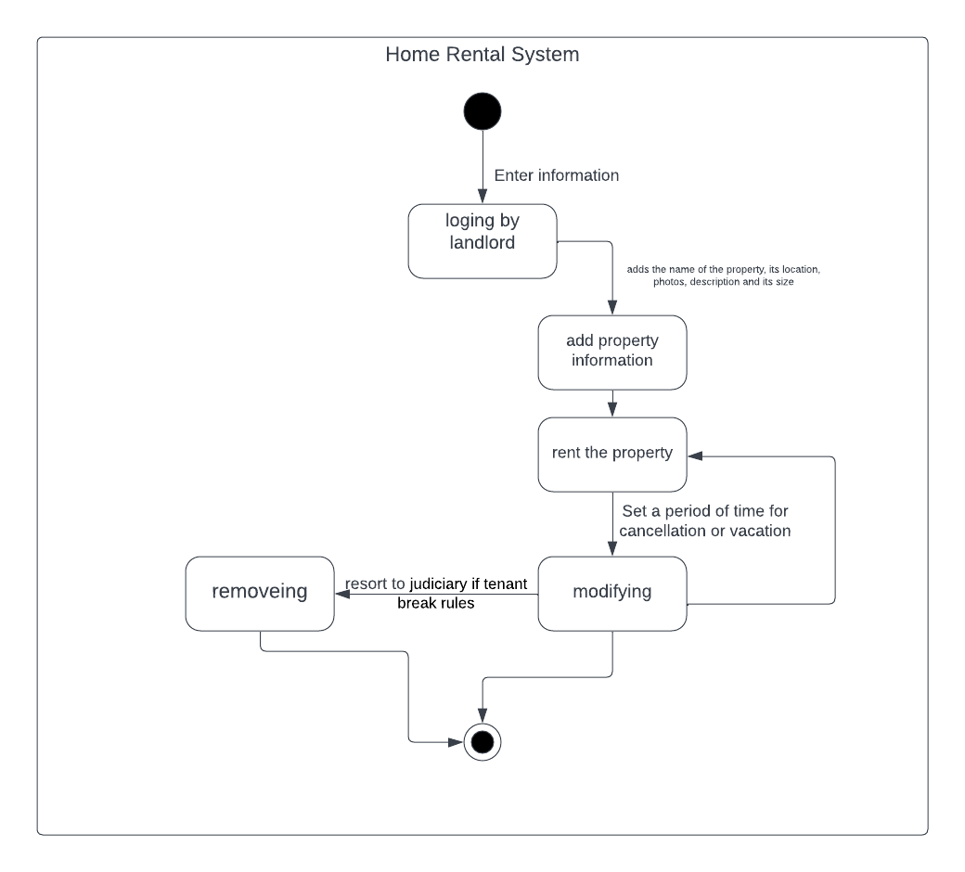
state diagram for landlord

Slide 13
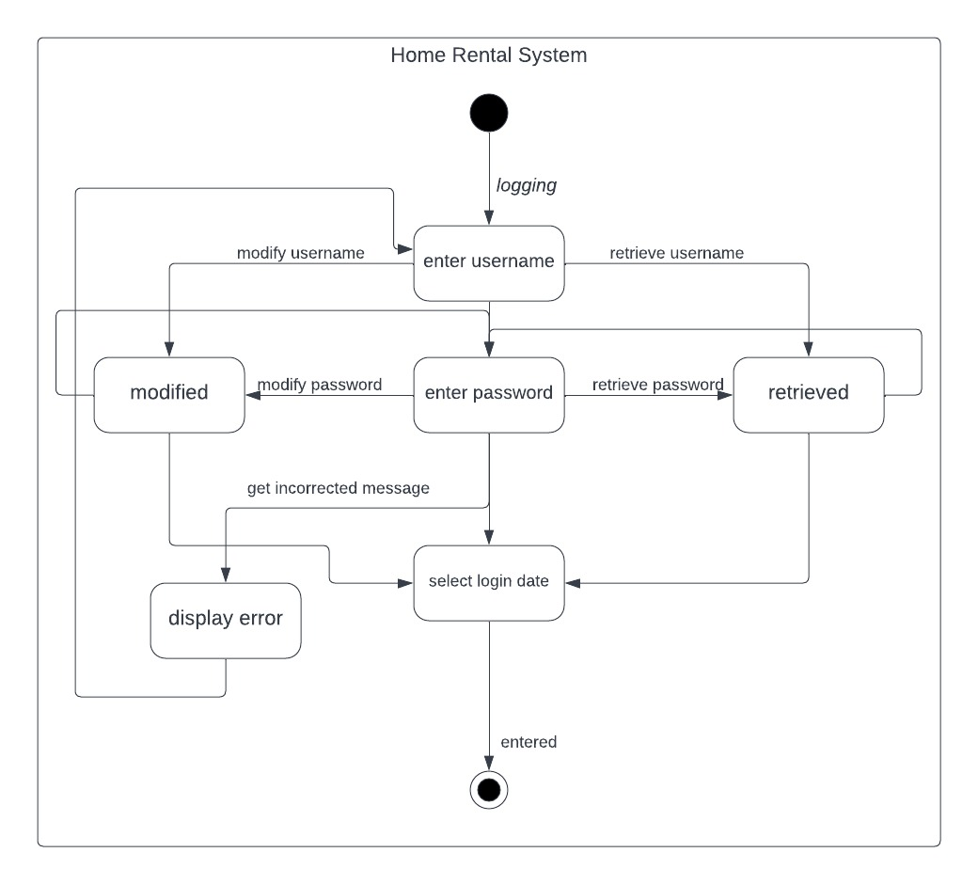
state diagram for login

Slide 14
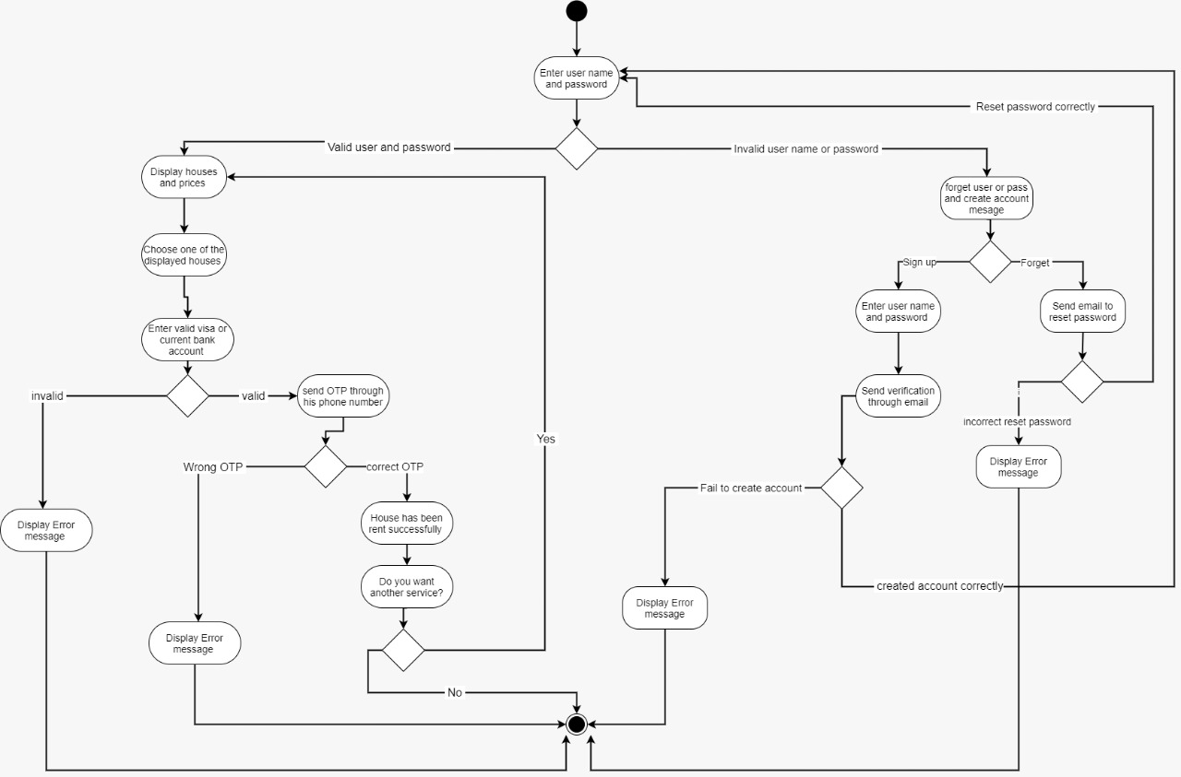
activity diagram

Slide 15
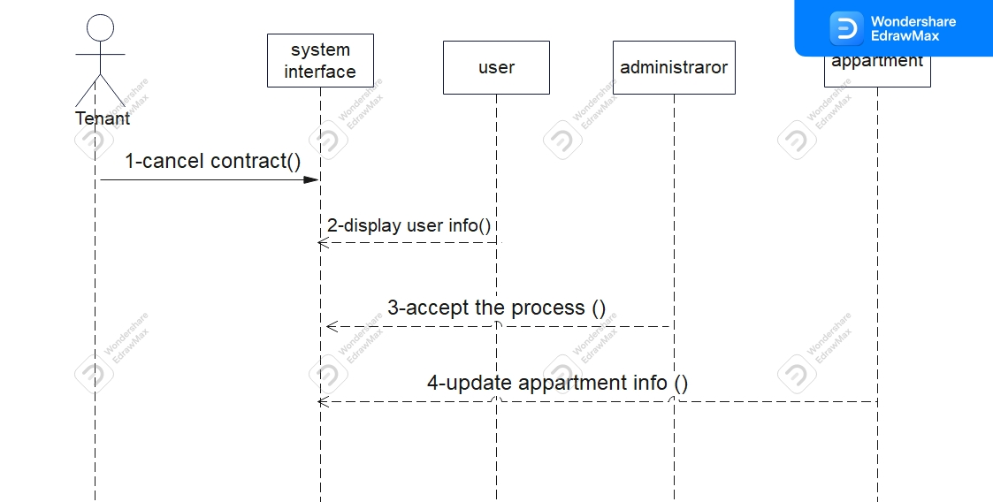
13-cancel contract sequence diagram

Slide 16
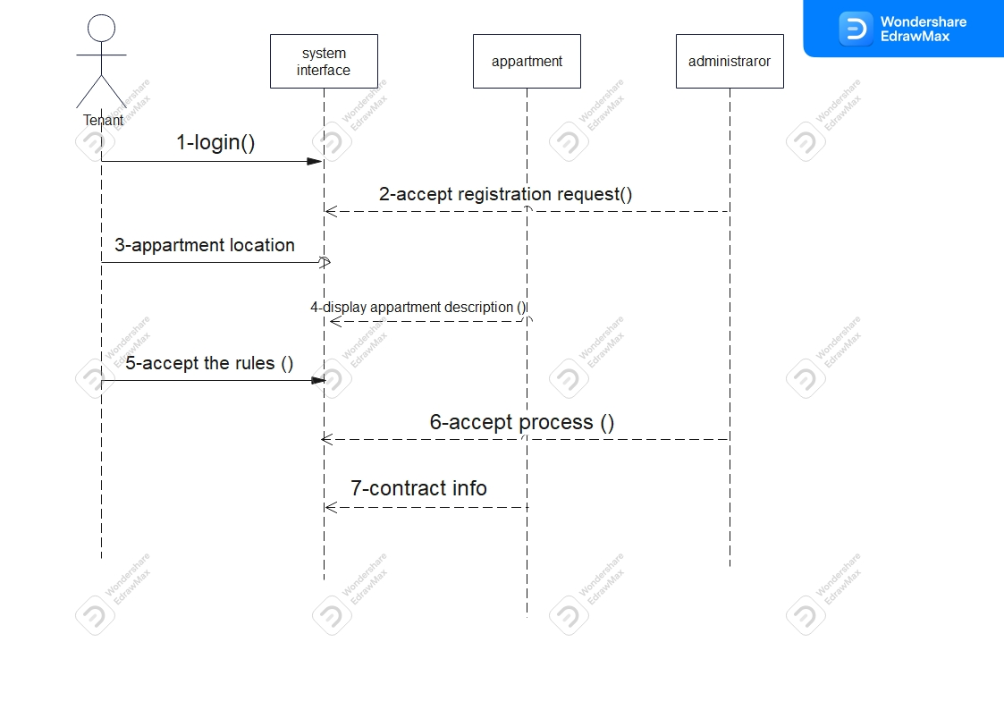
14-search for property sequence diagram

